Slide 1
Employee Data Analysis using Excel
STUDENT NAME:G.PAVITHRA
REGISTER NO:122200226 & asunm110122200226
DEPARTMENT:COMMERCE
COLLEGE DRBCCC HINDU COLLEGE

Slide 2
PROJECT TITLE
Employee Turnover Analysis using Excel

Slide 3


AGENDA
Problem Statement
Project Overview
End Users
Our Solution and Proposition
Dataset Description
Modelling Approach
Results and Discussion
Conclusion
3/21/2024 Annual Review

Slide 4

PROBLEM STATEMENT
Analyze employee turnover within the organization to identify trends, reasons for leaving, and departmental impacts. This analysis aims to provide insights into turnover rates over time, assess the average length of service, and understand the primary reasons for employee departures to inform strategies for improving employee retention. Use Excel to calculate turnover rates, visualize trends, and summarize key data points for actionable recommendations.

Slide 5

PROJECT OVERVIEW
Project Overview:Objective: Evaluate employee turnover to uncover trends and causes, and to guide retention efforts.
Scope:Analyze data on employee exits, including reasons for leaving, length of service, and departmental impacts.Calculate and visualize turnover rates and trends using Excel.
Methodology:Input and organize data in Excel.Use formulas and PivotTables for turnover calculations and trend analysis.Create charts to present findings on reasons and departmental turnover.
Outcome:Provide actionable insights to enhance employee retention and satisfaction.
.

Slide 6

WHO ARE THE END USERS?
HR Managers: To develop retention strategies and improve employee satisfaction.
Executives: To make informed decisions on workforce planning and organizational changes.
Department Heads: To understand turnover trends in their specific areas and address department-specific issues.
Recruiters: To refine hiring practices and improve onboarding processes.

Slide 7

OUR SOLUTION AND ITS VALUE PROPOSITION
Comprehensive Insights: Provides detailed analysis of turnover trends, reasons for leaving, and departmental impacts.
Data-Driven Decisions: Helps HR and management make informed decisions to enhance retention strategies and improve employee satisfaction.
Visualizations: Offers clear, actionable visuals like charts and graphs to easily interpret turnover data and trends.Efficiency: Streamlines data processing and analysis, saving time and reducing manual effort.

Slide 8
summary
To find the turnover of the employee using the excel
The result shown in the graph

Slide 9

DATASET DESCRIPTION
EMPLOYEE DETAILS
_KAGGLE.COM
42 FEATURES
NAME-TEXT
GENDER- MALE OR FEMALE
EDUCATION -BACHELORS, PHD
AGE- TEXT
TURNORNOVER - TEXT
EXPERIENCE
3/21/2024 Annual Review
9

Slide 10
MODELLING
DATA COLLECTION
COLLECTED FROM KAGGLE.
FEATURE COLLECTION
MERGE & CENTRE
EXPERIENCE LEVEL
NUMBER OF EMPLOYEE IN EACH
EXPERIENCE LEVEL.
10

Slide 11
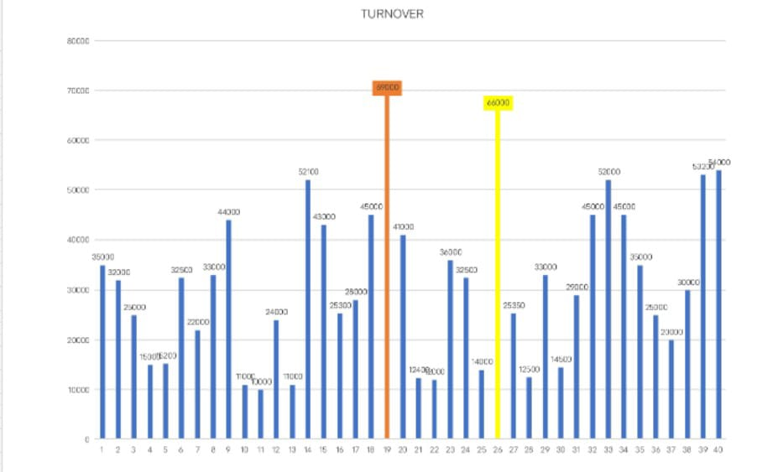
RESULTS
11

Slide 12
conclusion
IN THIS TURNOVER ANALYSIS THE SOME OF THE EMPLOYEES ARE GET HIGHER EXPERIENCE IN THE DEPARTMENT OF TURNOVER AND BACHELORS.

